Slide 1
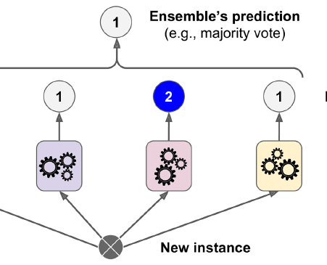
Ensemble learning
許志仲 (Chih-Chung Hsu)
Assistant Professor
Institute of Data Science
National Cheng Kung University

Slide 2
Ensemble learning
Basic idea: if one classifier works well, why not use multiple classifiers!

Slide 3
Ensemble learning
Basic idea: if one classifier works well, why not use multiple classifiers!
Training
learning alg
model 1
learning alg
model 2
Training
Data
…
learning alg
model m

Slide 4
Ensemble learning
Basic idea: if one classifier works well, why not use multiple classifiers!
Testing
model 1
prediction 1
example to label
model 2
prediction 2
How do we decide on the final prediction?
…
model m
prediction m

Slide 5
Ensemble learning
Basic idea: if one classifier works well, why not use multiple classifiers!
Testing
prediction 1
take majority vote
if they output probabilities, take a weighted vote
prediction 2
…
How does having multiple classifiers help us?
prediction m

Slide 6
Benefits of ensemble learning
Assume each classifier makes a mistake with some probability (e.g. 0.4, that is a 40% error rate)
model 1
Assuming the decisions made between classifiers are independent, what will be the probability that we make a mistake (i.e. error rate) with three classifiers for a binary classification problem?
model 2
model 3
Notes:
當有三個分類器進行二元分類問題時，假設每個分類器都有一定的機率犯錯誤（例如0.4，即錯誤率為40%）。
假設這些分類器的判斷是相互獨立的，也就是說一個分類器的錯誤不會影響其他分類器的錯誤，我們可以使用概率的知識來計算三個分類器都會出錯的機率。
首先，讓我們計算一個分類器正確的機率。如果錯誤率是0.4，那麼正確率就是1 - 0.4 = 0.6。
因為每個分類器的錯誤是獨立的，我們可以將它們的錯誤率相乘，以獲得三個分類器都會出錯的機率：
錯誤率 = 0.4（一個分類器出錯的機率） 機率（三個分類器都出錯）= 0.4 * 0.4 * 0.4 = 0.064
所以，當有三個分類器進行二元分類問題時，且每個分類器的錯誤率為40％時，三個分類器都會出錯的機率為0.064，即約為6.4％。
這個例子展示了如何計算在多個獨立分類器的情況下，三個分類器都會出錯的機率。通過將每個分類器的錯誤率相乘，我們可以得到整體錯誤率。這種方法在集成學習等應用中很有用，其中多個模型的預測被組合以提高整體性能。

Slide 7
Benefits of ensemble learning
Assume each classifier makes a mistake with some probability (e.g. 0.4, that is a 40% error rate)
model 1 | model 2 | model 3 | prob
C | C | C | .6*.6*.6=0.216
C | C | I | .6*.6*.4=0.144
C | I | C | .6*.4*.6=0.144
C | I | I | .6*.4*.4=0.096
I | C | C | .4*.6*.6=0.144
I | C | I | .4*.6*.4=0.096
I | I | C | .4*.4*.6=0.096
I | I | I | .4*.4*.4=0.064

Slide 8
Benefits of ensemble learning
Assume each classifier makes a mistake with some probability (e.g. 0.4, that is a 40% error rate)
model 1 | model 2 | model 3 | prob
C | C | C | .6*.6*.6=0.216
C | C | I | .6*.6*.4=0.144
C | I | C | .6*.4*.6=0.144
C | I | I | .6*.4*.4=0.096
I | C | C | .4*.6*.6=0.144
I | C | I | .4*.6*.4=0.096
I | I | C | .4*.4*.6=0.096
I | I | I | .4*.4*.4=0.064
0.096+
0.096+
0.096+
0.064 =
35% error!

Slide 9
Benefits of ensemble learning
3 classifiers in general, for r = probability of mistake for individual classifier:
binomial distribution
r | p(error)
0.4 | 0.35
0.3 | 0.22
0.2 | 0.10
0.1 | 0.028
0.05 | 0.0073
Notes:
這張投影片顯示了一個表格，表中列出了不同的錯誤概率（用 �r 表示）以及對應的 �(error)p(error)，這裡的 �(error)p(error) 似乎是指整體分類器的錯誤概率。這樣的設定通常用於集成學習中，尤其是當使用多個分類器並希望通過它們的組合來減少整體錯誤率時。
集成學習是機器學習中的一種策略，它結合多個學習算法的預測結果，以提高泛化能力和穩健性。其中一種常見的集成學習方法是投票法，如果每個分類器都是獨立的且錯誤率低於0.5（即比隨機猜測要好），那麼集成學習理論上可以通過多數投票來減少整體的錯誤率。
在這個表格中，對於每個分類器的錯誤概率 �r，我們可以使用二項分佈來計算整體錯誤概率 �(error)p(error)。二項分佈是一種概率分佈，它量化了在一系列的 �n 個獨立實驗中，每個實驗都有相同的成功概率 �p，發生確切 �k 次成功的概率。
假設我們有三個獨立的分類器，每個分類器判斷錯誤的概率分別為0.4, 0.3, 0.2等，這個表格可能是用來顯示，當這些分類器組合起來時，整體錯誤率會是多少。理想情況下，這個整體錯誤率會低於任何單個分類器的錯誤率。
舉個例子，如果我們有三個分類器，每個分類器的錯誤概率 �r 為0.3，那麼至少兩個分類器同時出錯的概率（即整體分類器出錯的概率）可以這樣計算：

Slide 10
Benefits of ensemble learning
5 classifiers in general, for r = probability of mistake for individual classifier:
r | p(error) 3 classifiers | p(error) 5 classifiers
0.4 | 0.35 | 0.32
0.3 | 0.22 | 0.16
0.2 | 0.10 | 0.06
0.1 | 0.028 | 0.0086
0.05 | 0.0073 | 0.0012

Slide 11
Benefits of ensemble learning
m classifiers in general, for r = probability of mistake for individual classifier:
(cumulative probability distribution for the binomial distribution)

Slide 12
Given enough classifiers…
r = 0.4

Slide 13
Obtaining independent classifiers
learning alg
model 1
learning alg
model 2
Training
Data
…
learning alg
model m
Where to we get m independent classifiers?

Slide 14
Idea 1: different learning methods
model 1
decision tree
learning alg
k-nn
learning alg
model 2
Training
Data
perceptron
…
naïve bayes
model m
gradient descent variant 1
learning alg
gradient descent variant 2
Pros/cons?
…

Slide 15
Idea 1: different learning methods
Pros:
Lots of existing classifiers already
Can work well for some problems
Cons/concerns:
Often, classifiers are not independent, that is, they make the same mistakes!
e.g. many of these classifiers are linear models
voting won’t help us if they’re making the same mistakes
Notes:
優點（Pros）:
許多現有的分類器： 機器學習中有許多現有的分類器可供使用，這些分類器是經過訓練的模型，可以用來識別不同的物件或情況。
在某些問題上表現良好： 這些現有的分類器在某些問題上可以表現得很好，例如，它們可能已經在特定領域經過了優化和調整，以達到高度的性能。
缺點/擔憂（Cons/Concerns）:
分類器之間的相依性： 通常，這些分類器並不是獨立的，這意味著它們可能會犯相同的錯誤。這種情況可能發生，特別是當不同的分類器都使用相似的模型或方法進行預測時。
例如，許多分類器是線性模型： 在某些情況下，多個分類器都可能是基於線性模型的，這意味著它們的預測方式相似。如果這些線性模型都容易犯相同的錯誤，那麼組合它們的預測可能不會有太大的幫助。
投票無法解決相同的錯誤： 如果多個分類器在相同的情況下都做出相同的錯誤，那麼使用投票方法（多數決）來進行集成學習可能不會有太大幫助，因為它們的投票仍然會導致相同的錯誤。
原理（Principle）:

Slide 16
Idea 2: split up training data
part 1
learning alg
model 1
part 2
learning alg
model 2
Training
Data
…
…
part m
learning alg
model m
Use the same learning algorithm, but train on different parts of the training data

Slide 17
Idea 2: split up training data
Pros:
Learning from different data, so can’t overfit to same examples
Easy to implement
fast
Cons/concerns:
Each classifier is only training on a small amount of data
Not clear why this would do any better than training on full data and using good regularization

Slide 18
Idea 3: bagging
Training
Data 1
learning alg
model 1
…
Training
Data
…
learning alg
model m
Training
Data m

Slide 19
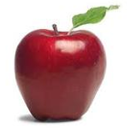
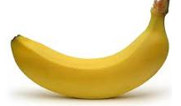
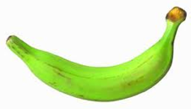
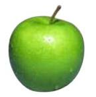
data generating distribution
Training data
Test set
data generating distribution

Slide 20
Ideal situation
Training data 1
Training data 2
…
data generating distribution
Notes:
but we can’t do this ☹

Slide 21
bagging
“Training” data 1
“Training” data 2
…
Training data
Use training data as a proxy for the data generating distribution
Notes:
使用訓練數據作為數據生成分布的代理：
Bagging的關鍵思想是，通過使用Bootstrap抽樣生成多個不同的訓練數據集，我們可以近似模擬出數據生成分布。這是因為每個Bootstrap樣本集都是原始數據的隨機抽樣，它們反映了原始數據的一些統計性質。因此，通過訓練多個模型，每個都在略有不同的數據子集上訓練，我們可以捕獲到數據的多樣性和不確定性。
這種方法對於減少模型的變異性非常有用，因為它可以降低單個模型對訓練數據的過度擬合（過度擬合）的風險。通過集成多個不同的模型預測，Bagging能夠提高模型的穩定性和性能。
總之，Bagging通過使用Bootstrap抽樣生成多個不同的訓練數據集，並使用這些數據集來訓練多個獨立模型，以改善機器學習模型的性能。它使用訓練數據作為數據生成分布的代理，以降低模型的變異性並提高整體性能。

Slide 22
sampling with replacements
“Training” data 1
Training data

Slide 23
sampling with replacements
“Training” data 1
pick a random example from the real training data
Training data

Slide 24
sampling with replacements
“Training” data 1
add it to the new “training” data
Training data

Slide 25
sampling with replacements
“Training” data 1
put it back (i.e. leave it) in the original training data
Training data

Slide 26
sampling with replacements
“Training” data 1
pick another random example
Training data

Slide 27
sampling with replacements
“Training” data 1
pick another random example
Training data

Slide 28
sampling with replacements
“Training” data 1
keep going until you’ve created a new “training” data set
Training data

Slide 29
bagging
create m “new” training data sets by sampling with replacement from the original training data set (called m “bootstrap” samples)
train a classifier on each of these data sets
to classify, take the majority vote from the m classifiers

Slide 30
bagging concerns
Training
Data 1
Won’t these all be basically the same?
Training
Data
…
Training
Data m

Slide 31
bagging concerns
For a data set of size n, what is the probability that a given example will NOT be select in a “new” training set sampled from the original?
Training data

Slide 32
bagging concerns
What is the probability it isn’t chosen the first time?
Training data

Slide 33
bagging concerns
What is the probability it isn’t chosen the any of the n times?
Each draw is independent and has the same probability
Training data

Slide 34
probability of overlap
Converges very quickly to 1/e ≈ 63%

Slide 35
bagging overlap
Training
Data 1
Won’t these all be basically the same?
Training
Data
…
On average, a randomly sampled data set will only contain 63% of the examples in the original
Training
Data m

Slide 36
When does bagging work
Let’s say 10% of our examples are noisy (i.e. don’t provide good information)
For each of the “new” data set, what proportion of noisy examples will they have?
They’ll still have ~10% of the examples as noisy
However, these examples will only represent about a third of the original noisy examples
For some classifiers that have trouble with noisy classifiers, this can help

Slide 37
When does bagging work
Bagging tends to reduce the variance of the classifier
By voting, the classifiers are more robust to noisy examples
Bagging is most useful for classifiers that are:
Unstable: small changes in the training set produce very different models
Prone to overfitting
Often has similar effect to regularization
Notes:
which methods that we’ve seen so far are more unstable?
decision trees

Slide 38
boosting

Slide 39
Ensemble learning
Basic idea: if one classifier works well, why not use multiple classifiers!

Slide 40
Ensemble learning
Basic idea: if one classifier works well, why not use multiple classifiers!
Training
learning alg
model 1
learning alg
model 2
Training
Data
…
learning alg
model m

Slide 41
Ensemble learning
Basic idea: if one classifier works well, why not use multiple classifiers!
Testing
model 1
prediction 1
example to label
model 2
prediction 2
…
model m
prediction m

Slide 42
Idea 4: boosting
training data
“training” data 2
“training” data 3
Data
Label
Weight
Data
Label
Weight
Data
Label
Weight
0
0.2
0
0.1
0
0.05
0
0.2
0
0.1
0
0.2
1
0.2
1
0.4
1
0.2
1
0.2
1
0.1
1
0.05
0
0.2
0
0.3
0
0.5

Slide 43

“Strong” learner
Given
a reasonable amount of training data
a target error rate ε
a failure probability p
A strong learning algorithm will produce a classifier with error rate <ε with probability 1-p

Slide 44
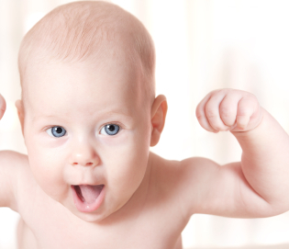
“Weak” learner
Given
a reasonable amount of training data
a failure probability p
A weak learning algorithm will produce a classifier with error rate < 0.5 with probability 1-p
Weak learners are much easier to create!

Slide 45
weak learners for boosting
Data
Label
Weight
0
0.2
0
0.2
weak learning algorithm
weak classifier
1
0.2
1
0.2
Which of our algorithms can handle weights?
0
0.2
Need a weak learning algorithm that can handle weighted examples

Slide 46
boosting: basic algorithm
Training:
start with equal example weights
for some number of iterations:
learn a weak classifier and save
change the example weights
Classify:
get prediction from all learned weak classifiers
weighted vote based on how well the weak classifier did when it was trained

Slide 47
boosting basics
Start with equal weighted examples
Weights:
Examples:
E1
E2
E3
E4
E5
Learn a weak classifier:
weak 1

Slide 48
Boosting
classified correct
classified incorrect
Weights:
Examples:
E1
E2
E3
E4
E5
We want to reweight the examples and then learn another weak classifier
How should we change the example weights?
weak 1

Slide 49
Boosting
Weights:
Examples:
E1
E2
E3
E4
E5
decrease the weight for those we’re getting correct
increase the weight for those we’re getting incorrect

Slide 50
Boosting
Weights:
Examples:
E1
E2
E3
E4
E5
Learn another weak classifier:
weak 2

Slide 51
Boosting
Weights:
Examples:
E1
E2
E3
E4
E5
weak 2

Slide 52
Boosting
Weights:
Examples:
E1
E2
E3
E4
E5
decrease the weight for those we’re getting correct
increase the weight for those we’re getting incorrect

Slide 53
Classifying
weak 1
prediction 1
weighted vote based on how well they classify the training data
weak 2
prediction 2
weak_2_vote > weak_1_vote since it got more right
…

Slide 54
Notation
x_{i} : example i in the training data
W_{i}: weight for example i, we will enforce:
classifier_{k}(x_{i}) +1/-1 prediction of classifier k example i

Slide 55
AdaBoost: train
for k = 1 to iterations:
classifierk = learn a weak classifier based on weights
calculate weighted error for this classifier
calculate “score” for this classifier:
change the example weights

Slide 56
AdaBoost: train
classifierk = learn a weak classifier based on weights
weighted error for this classifier is:
What does this say?

Slide 57
AdaBoost: train
classifierk = learn a weak classifier based on weights
weighted error for this classifier is:
What is the range of possible values?
prediction
did we get the example wrong
weighted sum of the errors/mistakes

Slide 58
AdaBoost: train
classifierk = learn a weak classifier based on weights
weighted error for this classifier is:
Between 0, if we get all examples right, and 1, if we get them all wrong
prediction
did we get the example wrong
weighted sum of the errors/mistakes

Slide 59
AdaBoost: train
classifierk = learn a weak classifier based on weights
“score” or weight for this classifier is:
What does this look like (specifically for errors between 0 and 1)?

Slide 60
AdaBoost: train
ranges from 1 to -1
errors of 50% = 0

Slide 61
AdaBoost: classify
What does this do?

Slide 62
AdaBoost: classify
The weighted vote of the learned classifiers weighted by α(remember αvaries from 1 to -1 training error)
What happens if a classifier has error >50%

Slide 63
AdaBoost: classify
The weighted vote of the learned classifiers weighted by α(remember αvaries from 1 to -1 training error)
We actually vote the opposite!

Slide 64
AdaBoost: train, updating the weights
update the example weights
Remember, we want to enforce:
Z is called the normalizing constant. It is used to make sure that the weights sum to 1
What should it be?

Slide 65
AdaBoost: train
update the example weights
Remember, we want to enforce:
normalizing constant (i.e. the sum of the “new” w_{i}):

Slide 66
AdaBoost: train
update the example weights
What does this do?

Slide 67
AdaBoost: train
update the example weights
correct positive
incorrect negative
correct
incorrect
?

Slide 68
AdaBoost: train
update the example weights
correct positive
incorrect negative
correct small value
incorrect large value
Note: only change weights based on current classifier (not all previous classifiers)

Slide 69
AdaBoost: train
update the example weights
What does the αdo?

Slide 70
AdaBoost: train
update the example weights
What does the αdo?
If the classifier was good (<50% error)αis positive:
trust classifier output and move as normal
If the classifier was back (>50% error)αis negative
classifier is so bad, consider opposite prediction of classifier

Slide 71
AdaBoost: train
update the example weights
correct positive
incorrect negative
correct small value
incorrect large value
If the classifier was good (<50% error)αis positive
If the classifier was back (>50% error)αis negative

Slide 72
AdaBoost justification
update the example weights
Does this look like anything we’ve seen before?

Slide 73
AdaBoost justification
update the example weights
Exponential loss!
AdaBoost turns out to be another approach for minimizing the exponential loss!

Slide 74
Other boosting variants
0-1 loss
Adaboost =
Logitboost
Loss
Brownboost
loss
Mistakes
Correct
Notes:
- many other “boosting” variants besides AdaBoost that can all be equated to different surrogate loss functions

Slide 75
Boosting example
Start with equal weighted data set

Slide 76
Boosting example
weak learner = line
What would be the best line learned on this data set?
h => p(error) = 0.5 it is at chance

Slide 77
Boosting example
How should we reweight examples?
This one seems to be the best
This is a ‘weak classifier’: It performs slightly better than chance.

Slide 78
Boosting example
What would be the best line learned on this data set?
reds on this side get less weight
blues on this side get more weight
reds on this side get more weight
blues on this side get less weight

Slide 79
Boosting example
How should we reweight examples?

Slide 80
Boosting example
What would be the best line learned on this data set?

Slide 81
Boosting example

Slide 82
Boosting example
f₁
f₂
f₄
f₃
The strong (non- linear) classifier is built as the combination of all the weak (linear) classifiers.

Slide 83
AdaBoost: train
for k = 1 to iterations:
classifierk = learn a weak classifier based on weights
weighted error for this classifier
“score” or weight for this classifier
change the example weights
What can we use as a classifier?
Anything that can train on weighted examples
For most applications, must be fast!
Why?
Each iteration we have to train a new classifier
Notes:
- what can we use as a classifier?

Slide 84
Boosted decision stumps
One of the most common classifiers to use is a decision tree:
can use a shallow (2-3 level tree)
even more common is a 1-level tree
called a decision stump ☺
asks a question about a single feature
What does the decision boundary look like for a decision stump?

Slide 85
Boosted decision stumps
One of the most common classifiers to use is a decision tree:
can use a shallow (2-3 level tree)
even more common is a 1-level tree
called a decision stump ☺
asks a question about a single feature
What does the decision boundary look like for boosted decision stumps?

Slide 86
Boosted decision stumps
One of the most common classifiers to use is a decision tree:
can use a shallow (2-3 level tree)
even more common is a 1-level tree
called a decision stump ☺
asks a question about a single feature
Linear classifier!
Each stump defines the weight for that dimension
If you learn multiple stumps for that dimension then it’s the weighted average
Notes:
Hou Yi-tong
22 Followers
·
About
Follow
Sign in
Get started
Responses
What are your thoughts?
Cancel
Respond
There are currently no responses for this story.
Be the first to respond.
AdaBoost介紹(中)演算法實作─弱分類器Decision stump
Hou Yi-tong
Apr 2, 2019·7 min read
一、弱分類器設計
二、輸入設定
三、AdaBoost設計
一、弱分類器設計
Weak Learner 指的是「比亂猜好一點」的模型，這種模型的好性質包含：複雜度低、訓練的成本低、不容易 Overfitting，例如 Decision Stump（決策樹墩？），這個模型其實就是把 Decision Tree 的深度限制在一層，可想而知，只能切一刀的 Decision Tree 大概不會太好用，但是它卻滿足 Weak Learner 的性質，能夠快速的訓練、並且做出的預測能夠比亂猜好一些。此篇實作中即採用Decision stump。
Decision stump基本原理：
從樹（數據結構）的觀點來看，它由一個內部節點（internal node）也即根節點（root）與終端節點（terminal node）也即葉子節點（leaves）直接相連。用作分類器（classifier）的 decision stump 的葉子節點也就意味著最終的分類結果。
從實際意義來看，decision stump 根據一個屬性的一個判斷就決定了最終的分類結果，比如根據水果是否是圓形判斷水果是否為蘋果，這體現的是單一簡單的規則（或叫特徵）在起作用。
顯然 decision stump 僅可作為一個 weak base learning algorithm（它會比瞎猜0.5稍好一點點，但好的程度十分有限），常用作集成學習中的 base algorithm，而不會單獨作為分類器。
既然 decision stump 僅可對一個屬性進行一次判斷獲取最終的分類結果，顯然我們尋找具有最低錯誤率的單層決策樹。
所要優化的目標函數為：
i表示屬性列，N為樣本集的大小，d為屬性列的個數。
二、Data設定
本次設定的輸入數據分兩種一種為分叢的數據
datMat,classLabels=make_gaussian_quantiles(n_samples=13000,n_features=2,n_classes=2,mean=[1,2],cov=2) plt.scatter(datMat[:,0],datMat[:,1],marker='o',c=classLabels,s=3) plt.show()
另一種為高斯分布，並分割成兩塊，注意兩者並非重疊的
datMat,classLabels=make_blobs(n_samples=5,n_features=2,centers=[[1,1],[4,4]],cluster_std=[0.4,0.2]) plt.scatter(datMat[:,0],datMat[:,1],marker='o',c=classLabels,s=3) plt.show()
對於生產得到的label，紫色者為0，黃色者為1，為了後續可以利用sign(.)做判斷，會將之轉成±1。
三、針對Data設計弱分類器：
虛擬碼如下：
▪ Set the minError to inf
▪ For every features( x , y ) in the dataset：
▪ For every step：
▪ For each inequality( Less Than ,Greater Than)：
▪ Build a secision stump
▪ Test it with the weighted dataset
▪ If error <= min minError：
▪ set this stump as the best stump
▪ Return the best stump
Decision stump實作(分二類為例)：
分段器(應該只有我這樣命名，至少我覺得這樣很傳神XDD)：
def stumpClassify(dataMatrix,dimen,threshVal,threshIneq): retArray = np.ones((np.shape(dataMatrix)[0],1)) if threshIneq == 'lt': retArray[dataMatrix[:,dimen]<=threshVal] =-1 else: retArray[dataMatrix[:,dimen]>threshVal] =-1 return retArray其中，dataMatrix為輸入數據，dimem為檢查的維度輸入(0：x軸、1：y軸)，threshVal為分割值，以此做分割分類的依據，threshIneq為目前要檢查的符號(≦、＞)。
建立樹：
def buildStump(dataArr, classLabels,D): dataMatrix = np.mat(dataArr) labelMat = np.mat(classLabels).T m,n = np.shape(dataMatrix) numSteps = 100.0 bestStump,bestClasEst = {},np.mat(np.zeros((m,1))) minError = float("inf")其中，dataArr為資料矩陣、classLabels為標記矩陣，D為分布權重，numSteps為threshVal移動的步數，數字越大一步越小，如下圖。
for i in range(n): rangMin = dataMatrix[:,i].min() rangMax = dataMatrix[:,i].max() stepSize = (rangMax - rangMin)/numSteps決定看不同軸情況下的步伐大小。
stepSize = (rangMax - rangMin)/numSteps for j in range(-1,int(numSteps)+1): for inequal in ['lt','gt']: threshVal = (rangMin + float(j)*stepSize) predictedVals = \ stumpClassify(dataMatrix,int(i),threshVal,inequal) errArr = np.mat(np.ones((m,1))) errArr[predictedVals == labelMat] = 0 weightedError = D.T*errArr if weightedError < minError: minError = weightedError bestClasEst = predictedVals.copy() bestStump['dim'] = i bestStump['thresh'] = threshVal bestStump['ineq'] = inequal在不同軸的情況下來移動threshVal決定何者為較好的分割，並作保存最後回傳結果。
return bestStump,minError,bestClasEst整體如下，
WRITTEN BY
Hou Yi-tong
Follow
2
2
Adaboost
Boost
Classifier
Decision Tree
Python
More from Hou Yi-tong
Follow
More From Medium
Artificial Intelligence Still Isn’t All That Smart
Bloomberg Opinion in Bloomberg Opinion
Introduction Guide to Decision Trees and Random Forests
Surbhi Singh
Machine Learning with Julia / ScikitLearn.jl
Erdal Sönük in Analytics Vidhya
Python Deep Learning: Part 3
Jon C-137
Predicting Pokemon Battle Winner using Machine Learning
Saurabh Charde in AI Enigma
What is Gradient Boosting? How is it different from Ada Boost?
Abhiroop Choudhury in Analytics Vidhya
Discovering beer type from ingredients using Classification
Michelangiolo Mazzeschi in Towards AI
Debugging Classifiers With Confusion Matrices
Dhruv Nair in The Startup
About
Help
Legal

Slide 87
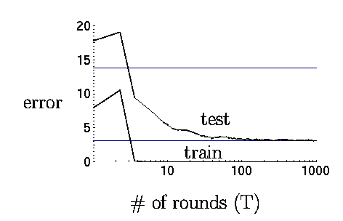
Boosting in practice
Very successful on a wide range of problems
One of the keys is that boosting tends not to overfit, even for a large number of iterations
Using <10,000 training examples can fit >2,000,000 parameters!

Slide 88
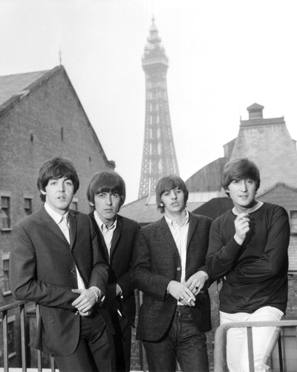
Adaboost application example: face detection

Slide 89
Adaboost application example: face detection

Slide 90
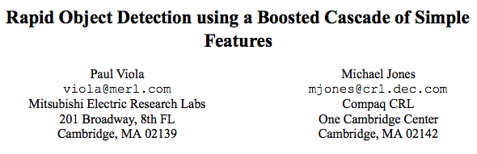
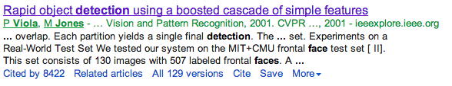

Slide 91

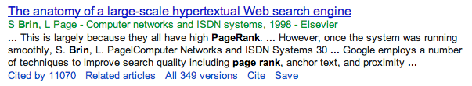
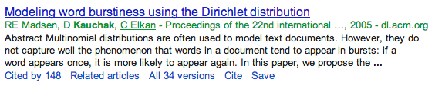
To give you some context of importance:
or:

Slide 92
Robust Real-time Object Detection
Paul Viola and Michael Jones

Slide 93
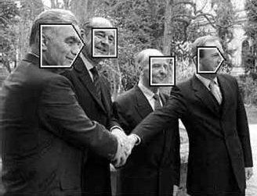
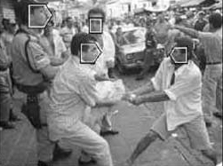
Object Detection Using the Statistics of Parts
Henry Schneiderman and Takeo Kanade
Object detectors trained using information on image “parts”

Slide 94
So what’s a “part”?
Intuitively a part is a portion of an object…
For the purposes of image processing a part is a group of features that are statistically dependent.
The assumption being that certain groups of pixels in an image tend to appear together and are (relatively) independent of other groups.
Notes:
假設圖像中的某些像素組傾向於一起出現並且（相對）獨立於其他組。

Slide 95
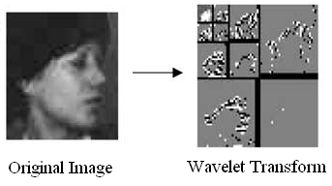
Choosing parts
First wavelet transform is applied to the image. This decorrelates the pixels, localizing dependencies and therefore producing more “focused” parts.
A wavelet transform is the result of applying a series of wavelet filters to an image. The result is horizontal, vertical and diagonal responses for several scales.
Notes:
首先對圖像應用小波變換。這使像素去相關，定位依賴關係，因此產生更多“集中”的部分。
小波變換是對圖像應用一系列小波濾波器的結果。結果是多個尺度的水平、垂直和對角線響應。

Slide 96
Choosing parts (2)
Next, seventeen hand designed “local operators” are applied across the image.
These local operators combine pairs of filter results from the wavelet transform. Some relate horizontal to vertical responses, whereas others relate responses to those of the same orientation but different scale.
The output is discrete over 38 values. These are the “parts”.
Are we even talking about “parts” of anything anymore..?
Notes:
接下來，將 17 個手工設計的“本地算子”應用到整個圖像中。
這些局部算子結合了來自小波變換的濾波結果對。有些將水平響應與垂直響應相關聯，而另一些則將響應與相同方向但不同規模的響應相關聯。
輸出是離散的超過 38 個值。這些是“部分”。
我們是否還在談論任何事物的“部分”……？

Slide 97
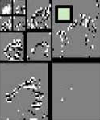
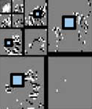
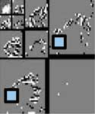
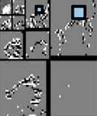
Choosing parts (3)
Intra-Subband
Local operator
Inter-frequency
Local operator
“Parts”
Inter-orientation
Local operator
Inter-frequency/ Inter-orientation
Box o’ Mystery

Slide 98
Classification by parts
Using this definition of “parts” and the base assumption that pixels within parts are independent of those outside parts, a classifier can be obtained:
A simple independence assumption…
Notes:
使用“部件”的這個定義和部件內的像素獨立於外部部件的基本假設，可以得到一個分類器：

Slide 99
Learning by parts
P(part | object) and P(part | non-object) are calculated with a simple MLE:
AdaBoost is used to improve classification accuracy (more on this later).

Slide 100
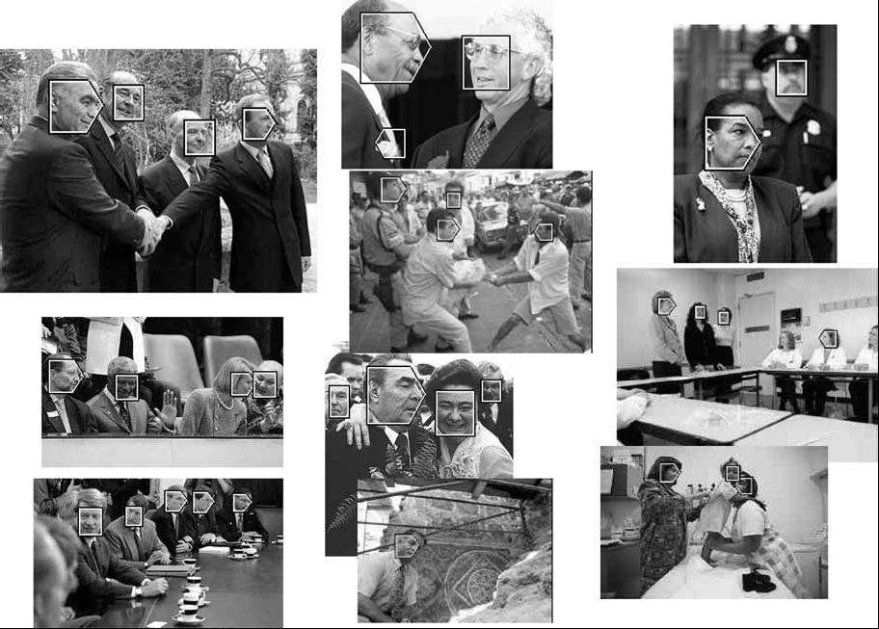
Detection examples

Slide 101
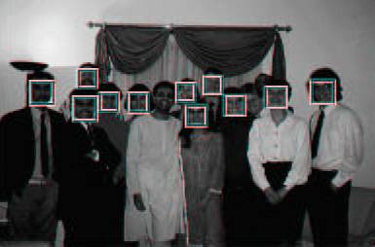
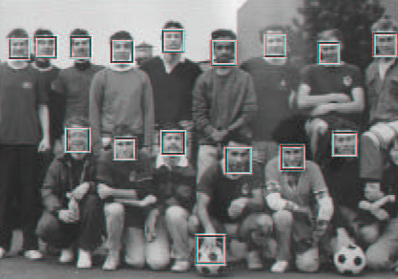
Robust Real-time Object Detection
Paul Viola and Michael Jones
High-speed face detection with good accuracy

Slide 102
The detector
A simple filter bank with learned weights applied across the image
But with some notable performance-boosting implementation tricks…
Notes:
一個簡單的濾波器組，在圖像上應用了學習的權重
但是有一些顯著的性能提昇實現技巧……

Slide 103
Three big speed gains
Integral image representation and rectangle features
Selection of a small but effective feature set with AdaBoost
Cascading simple detectors to quickly eliminate false positives
Notes:
積分圖像表示和矩形特徵
使用 AdaBoost 選擇一個小而有效的功能集
級聯簡單檢測器以快速消除誤報

Slide 104
The integral image representation
An image representation that stores the sum of the intensity values above and to the left of the image point.
x, y
IntegralImage(x,y) = Sum of the values in the grey region
So what’s it good for?
Notes:
存儲圖像點上方和左側的強度值總和的圖像表示。

Slide 105
The integral image representation
This representation allows rectangular feature responses to be calculated in constant time.
Rectangular features are simple filters that have only +1 and -1 values and are… well… rectangles.
Two-rectangle features
Three-rectangle features
I bet you can guess what these are called
With an integral image and rectangular features, filter responses are just a fixed number of table lookups and additions away.
Notes:
這種表示允許在恆定時間內計算矩形特徵響應。
矩形特徵是只有 +1 和 -1 值的簡單過濾器，並且是……嗯……矩形。 借助完整的圖像和矩形特徵，過濾器響應只需進行固定數量的表格查找和添加即可。

Slide 106
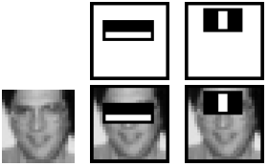
Speed gain number two: AdaBoost selected features
AdaBoost is used to select the best set of rectangular features.
AdaBoost iteratively trains a classifier by emphasizing misclassified training data.
Assigned feature weights are used to select the “most important” features.
Top two features weighted by AdaBoost
Notes:
AdaBoost 用於選擇最佳矩形特徵集。
AdaBoost 通過強調錯誤分類的訓練數據來迭代訓練分類器。
分配的特徵權重用於選擇“最重要”的特徵。

Slide 107
Intermediate results
The face detector using 200 AdaBoost-selected features achieved a 1 in 14084 false positive rate when turned for a 95% classification rate.
An 384x288 image took 0.7 seconds to scan.
There are more improvements to be made…
Notes:
使用 200 個 AdaBoost 選擇的特徵的人臉檢測器在分類率為 95% 時實現了 1 分 14084 的誤報率。
掃描 384x288 圖像需要 0.7 秒。
還有更多的改進要做……

Slide 108
Speed gain number three: Cascading detectors
Instead of applying all 200 filters at every location in the image, train several simpler classifiers to quickly eliminate easy negatives.
Each successive filter can be trained on true positives and the false positives passed by the filters before it.
The filters are trained to allow approximately 10% false positives.
Image segment
200 Features
Accept
Image segment
20 Features
20 Features
…
Accept
Reject
Reject
Reject
Notes:
與其在圖像中的每個位置都應用所有 200 個過濾器，不如訓練幾個更簡單的分類器來快速消除簡單的否定。
每個連續的過濾器都可以在真陽性和之前過濾器通過的假陽性上進行訓練。
過濾器經過訓練以允許大約 10% 的誤報。

Slide 109
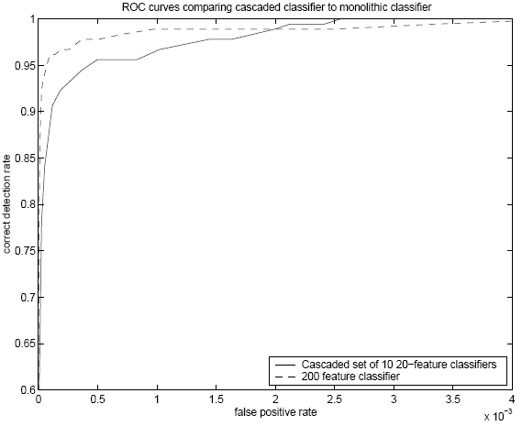
Cascade improvements
The cascading features provide comparable accuracy, but ten times the speed.
Notes:
級聯功能提供了相當的精度，但速度提高了十倍。

Slide 110
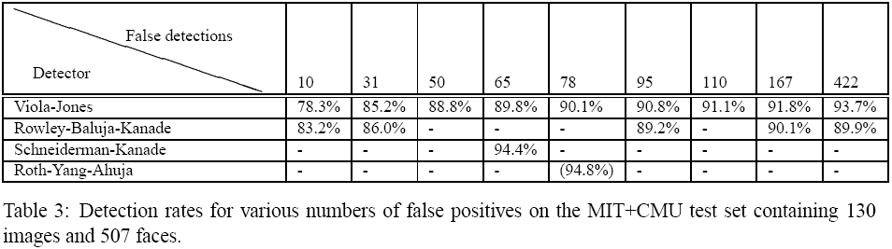
Results
Good accuracy with very fast evaluation.
0.067 Seconds per image.
An average of 8 out of 4297 features evaluated.

Slide 111
Detection examples

Slide 112
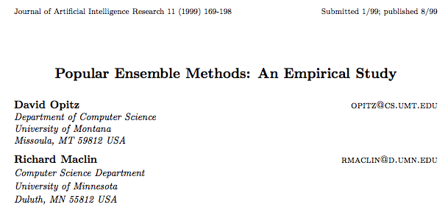
Bagging vs Boosting
http://arxiv.org/pdf/1106.0257.pdf

Slide 113
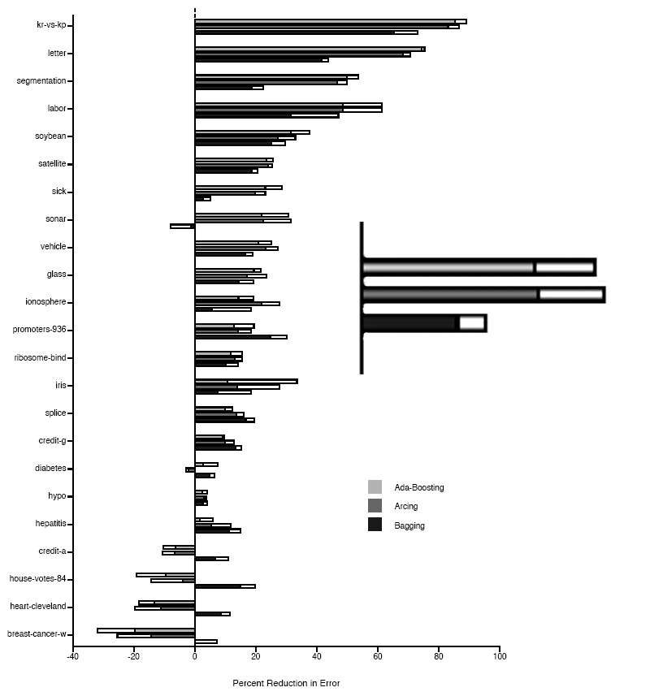
Boosting Neural Networks
Change in error rate over standard classifier
Ada-Boosting
Arcing
Bagging
White bar represents 1
standard deviation

Slide 114
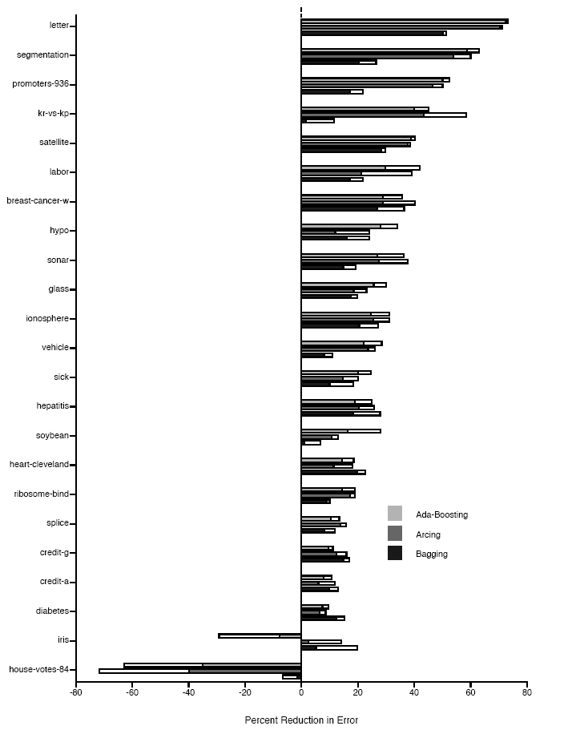
Boosting Decision Trees

